Slide 1
Deploying a 3-tier django application
Alex Kinyanjui Nduta(wasremoved)

Slide 2
Goal:
Deploy a containerized , 3-tier web application on a production-grade Kubernetes
cluster
Key objectives:
Automate the deployment process
Ensure system stability and security
Gain practical experience with cloud-native tools(Docker, Kubernetes)
Create a portable and scalable infrastructure

Slide 3

The App: Twender API
This is a bus hailing application designed to simulate a conductor’s daily activities and automating them i.e onboarding, payment, offboarding, trip tracking
Technology stack:
Django
Django REST Framework
MySQL
Gunicorn
- Core functionality:
- User registration/login
- Role-based access
- Trip creation
- Conductor manifest view

Slide 4
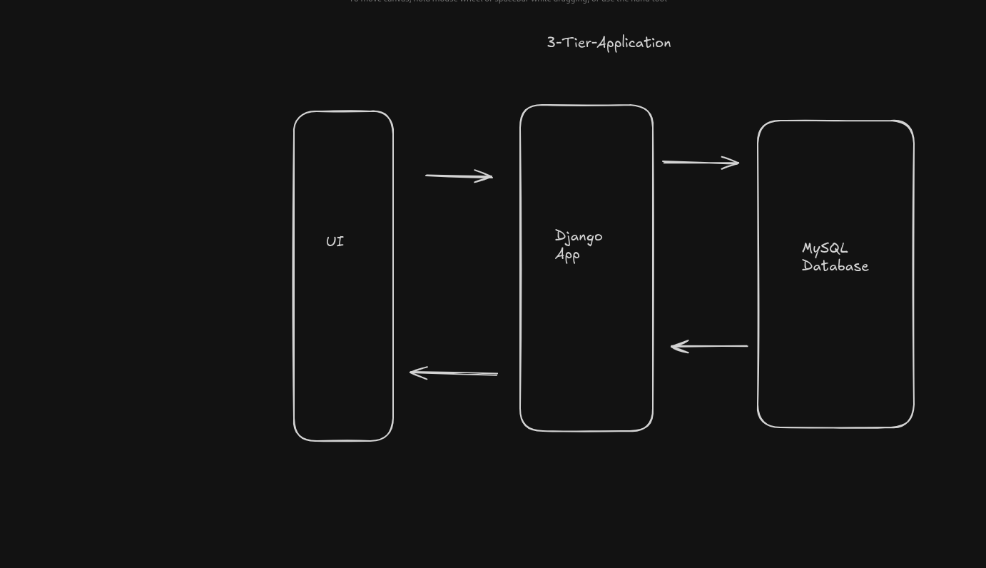
Structure of the 3-tier application

Slide 5
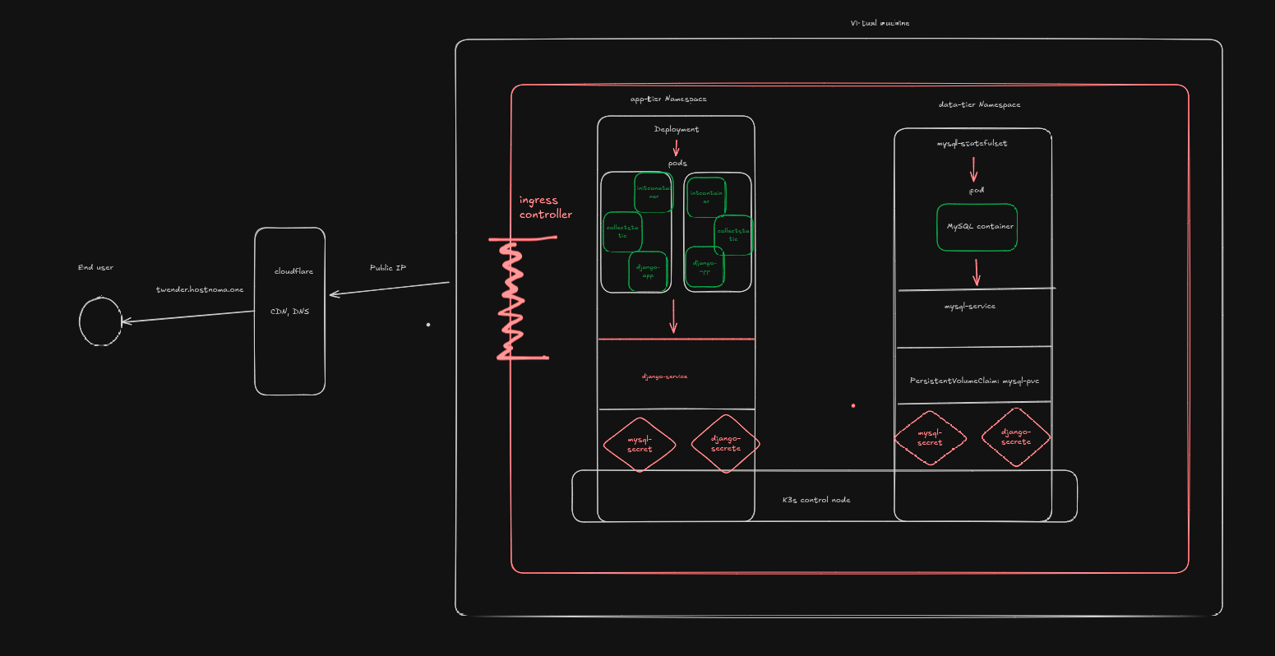
Architecture overview:

Slide 6
The Builf process: The Dockerfile
Purpose: Create a portable, production-ready image of the application
Key features:
Use of a specific base image(python3.10-bullseye)
Installation of system dependencies mysqlclient
Use of non-root user for enhanced security
Running the app with a production server(gunicorn)

Slide 7
The Build process: Kubernetes Manifests
The kubernetes manifests are YAML files that declare the desired state of the system
Available manifests:
Namespace: to create isolated environments
Secret: To securely store passwords and API keys
persistentVolumeClaim: To request durable storage for the data
Django-deployment: deploy the django application
Ingress: define how traffic is handled for the cluster

Slide 8
Deep Dive: The data-tier(MySQL)
Why a StatefulSet over Deployment?
Stable identity and storage for the database
What does the mysql-service do?
Provide a stable DNS name for the django app to connect to
What is the relationship between the Secret and the MySQL database?

Slide 9
Deep Dive: The Application Tier(Django)
What is the role of a deployment?
Manage replicas and enabling rolling updates
What is the role of the initContainers?
They are best practice when running a production application so as to run database migrations

Slide 10
The Entry Point: Kubernetes Ingress
What is the role of the ingress controller?
Gatekeeper to the cluster
How do the rules route traffic to:
Twender.hostnoma.one
django-service

Slide 11
Security & Automation: cert-manager
The problem: Managing security certs is difficult and error-prone
Solution:
Cert-manager => the automated solution
What is the role of:
ClusterIssuer => provission free valid TLS certificate from Let’s Encrypt

Slide 12
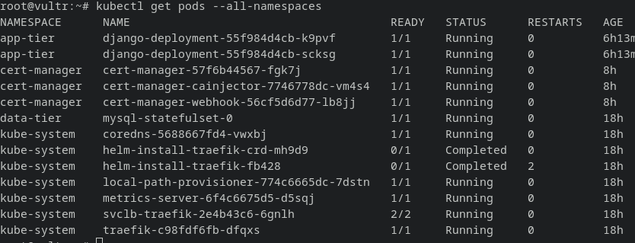
Proof of work: Live system

Slide 13
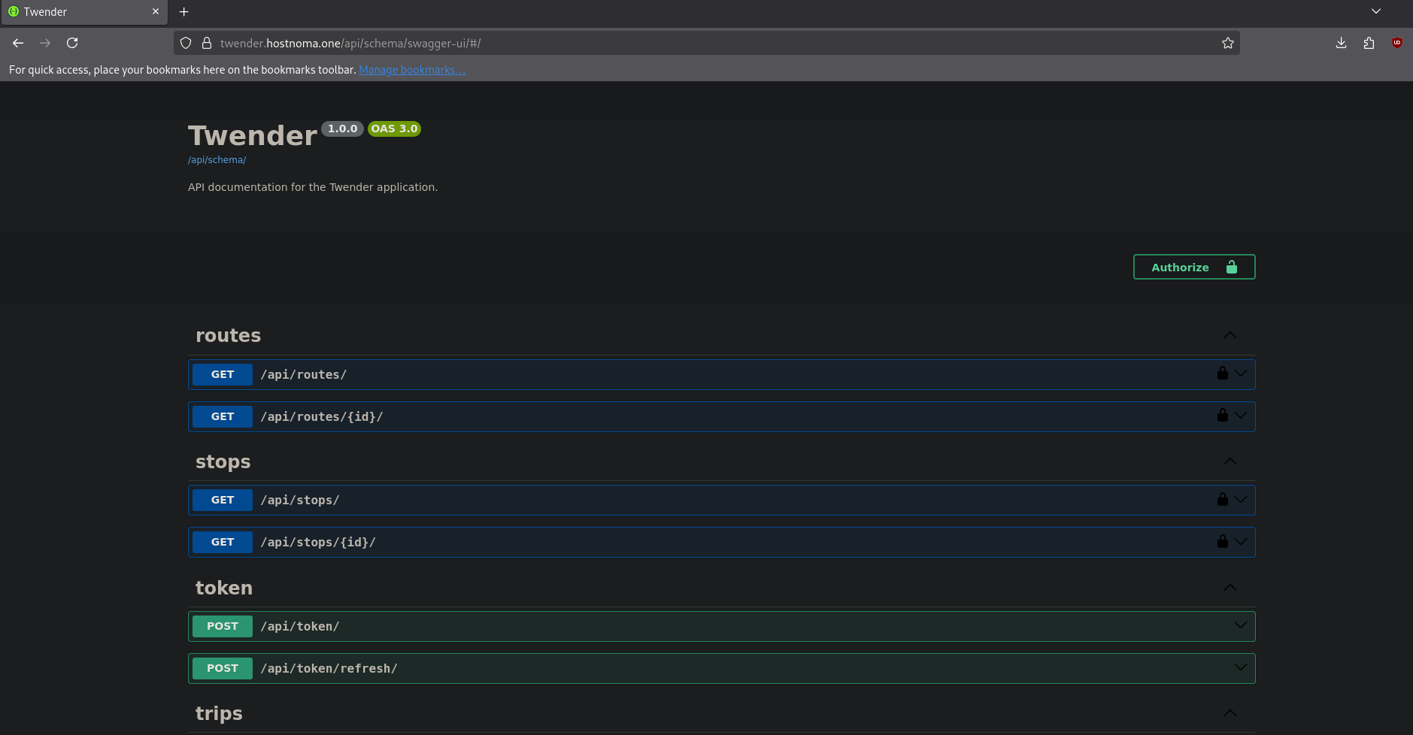

Slide 14
Build documentation
IaaC:
Dockerfile
K8s manifest files
README.md

Slide 15
Key Learnings
The power of abstraction:
How k8s hides the complexity of managing individual nodes
Declarative configuration:
Benefit of defining what you want in YAML and k8s figures out the rest
Importance of security:
Necessity of using non-root user, secrets and HTTPS from the start
Debugging in a distributed system:
How to use kubectl logs and `kubectl describe`

Slide 16
How will I apply this?
This project contains a complete, production-ready template for deploying future web application
Skills learnt(kubectl, YAML, Docker and Helm) are applicable to the CKA and KCNA certs
Understanding this workflow is essential for any modern DevOps or BackEnd Engineering role

Slide 17
Any Questions?
Thank you for your time

